Slide 1

Feasibility Study
2

Slide 2









Technical Feasibility
Freely accessible technologies with huge community support
Affordable VPS hosting with first 12 months completely for a capable server.
We have access to feature-rich IDEs

Slide 3


Legal and Ethical Feasibility
Free & Open-source technologies with no legal restrictions for commercial use
No sharing of user data with 3rd parties.
Properly written User agreements and Privacy Policy
Encrypting sensitive user data such as passwords.

Slide 4
Legal and Ethical Feasibility contd.
Invoices will be sent to email with online payments to ensure customer safety
No sharing of user data with 3rd parties.

Slide 5

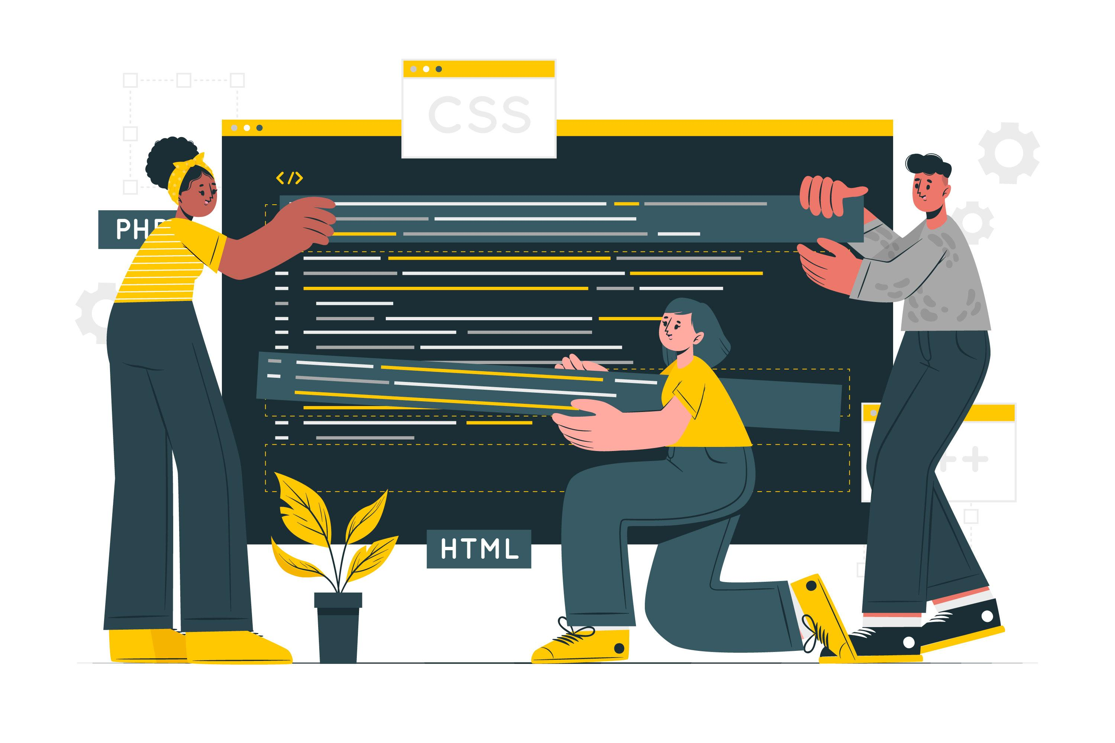

Economic Feasibility
We use Open-source technologies which are completely free
Internet and Electricity costs are bearable for the developers
Using a free vps hosting service until there is a paying client

Slide 6



Operational Feasibility
Intuitive and user-friendly UI makes it easier for users to adapt.
Easy and efficient supervising of vehicle services/repairs
Automatically synced online orders and physical orders makes it easy to manage stock

Slide 7


Operational Feasibility contd.
Real-time notifications makes it easy to keep track of ongoing jobs.
Instantly accessible previous service records improves efficiency of technicians.

Slide 8





Technologies to be used
2

Slide 9
Technologies
Databases
MySQL
Redis
Frontend
HTML5
CSS3
JavaScript
IDE
Backend
VS Code
PhpStorm
PHP

Slide 10



Technologies cont.
Project Management
Trello
Version Controlling
Git
GitHub
Hosting
Atlantic.net

